Slide 1
Electric Complaint System
Final Project
Presented by: Abuzer Zuber SHAIKH

Slide 2
Problem Statement
Manual complaint systems are slow and inefficient
Lack of proper complaint tracking
No easy way to submit electric-related issues offline

Slide 3
Objective
To simplify the complaint registration process
To provide status tracking for users
To help admin manage and resolve electric complaints

Slide 4
Technology Stack
Frontend: HTML, CSS, JAVASCRIPT
Backend: Python (Django)
Database: MySQL
Tools: VS Code, MySQL Workbench

Slide 5
System Features
User login/register
Submit electric complaints by category
Complaint history and status view
Admin panel for managing complaints
Success messages and validations

Slide 6
System Architecture / Flow
User registers/logs in
Submits complaint by category
Data stored in MySQL
Admin views and updates status
User can See Their complaint & status

Slide 7
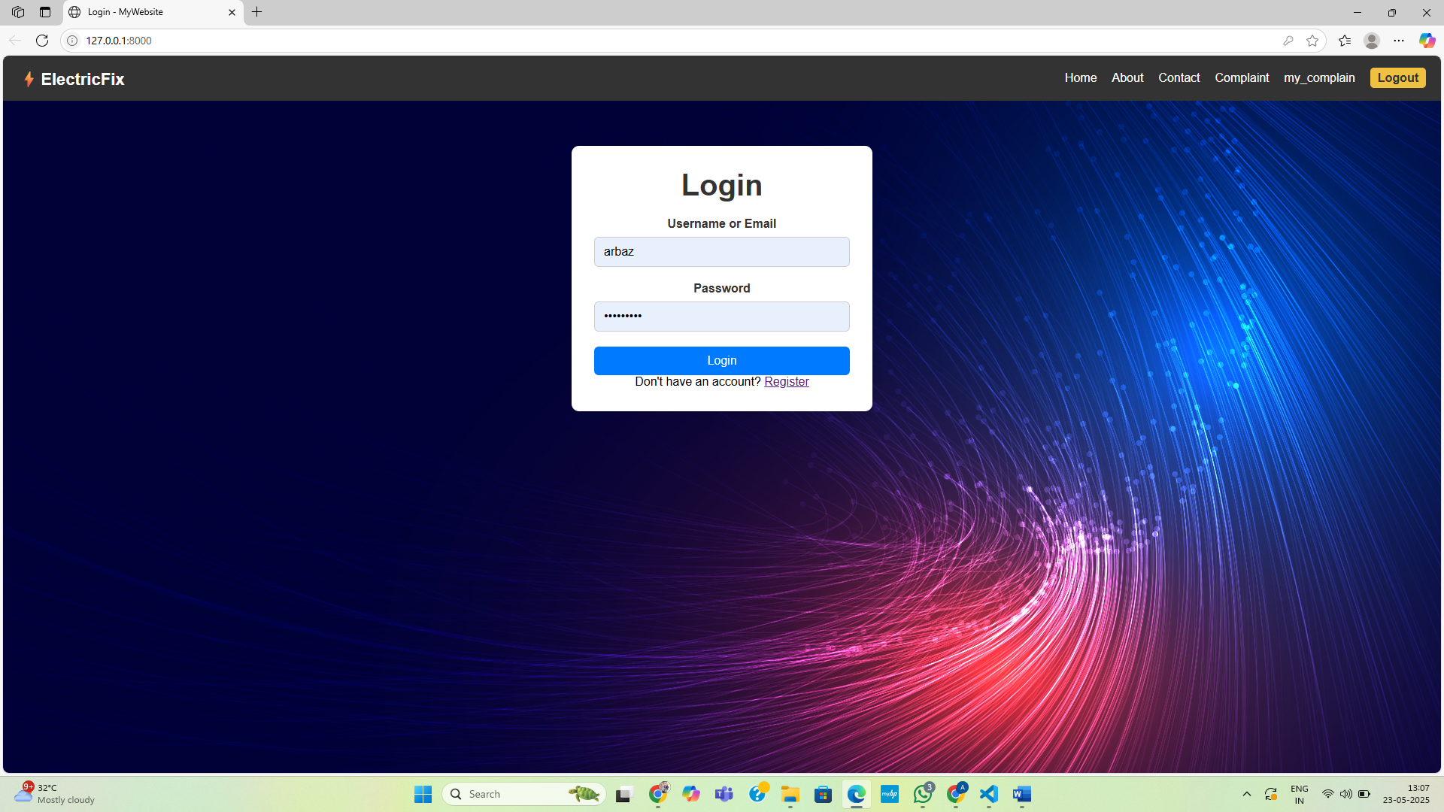
Screenshots / Demo
Login/Register Page

Slide 8
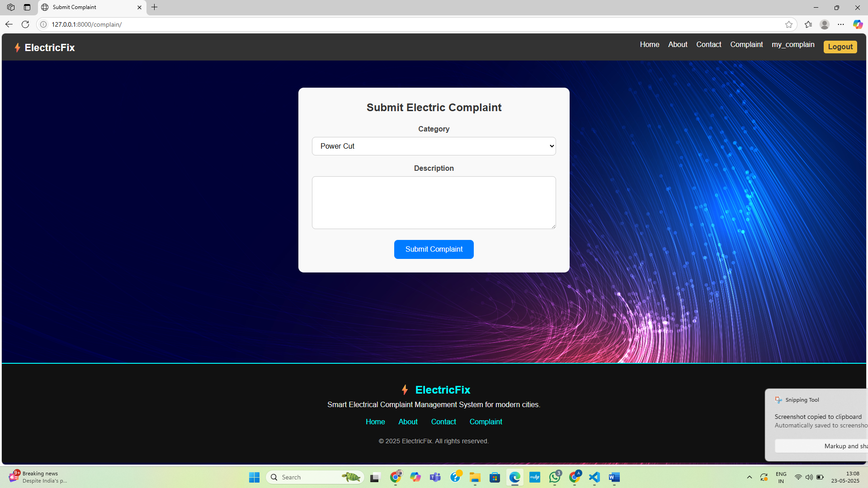
Complaint Submission Form

Slide 9
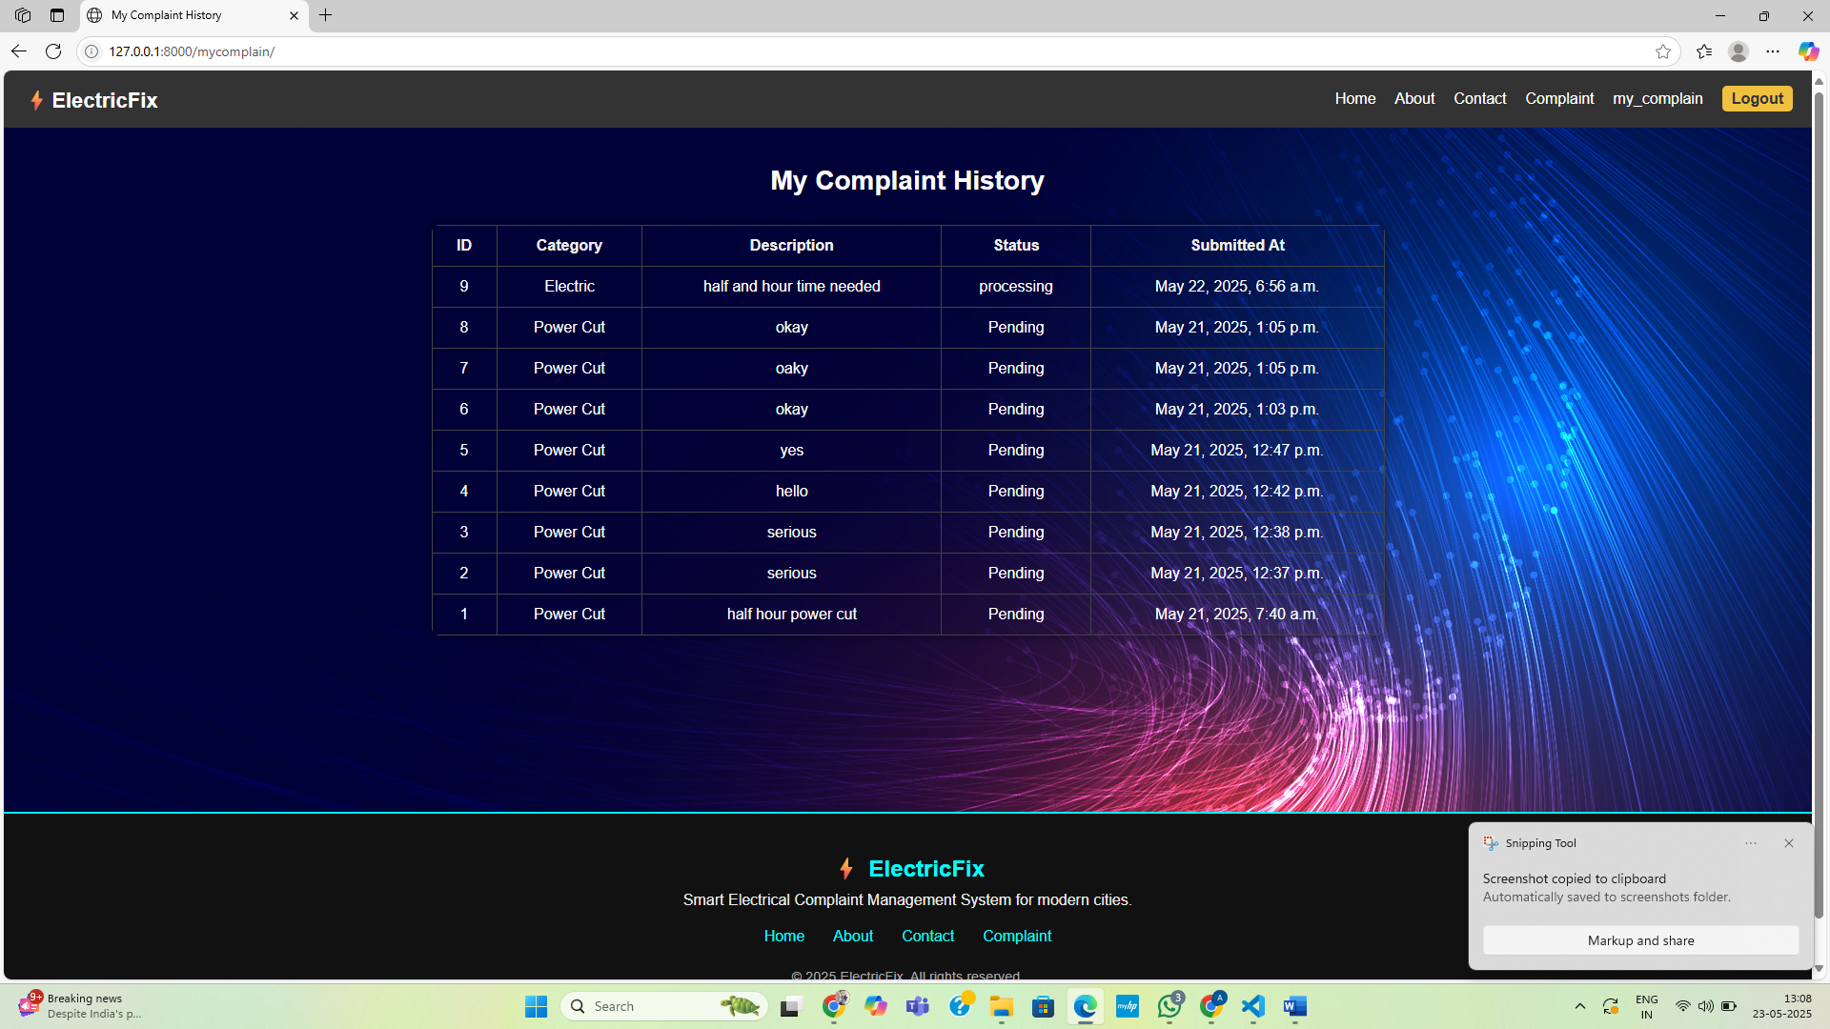
Complaint List

Slide 10
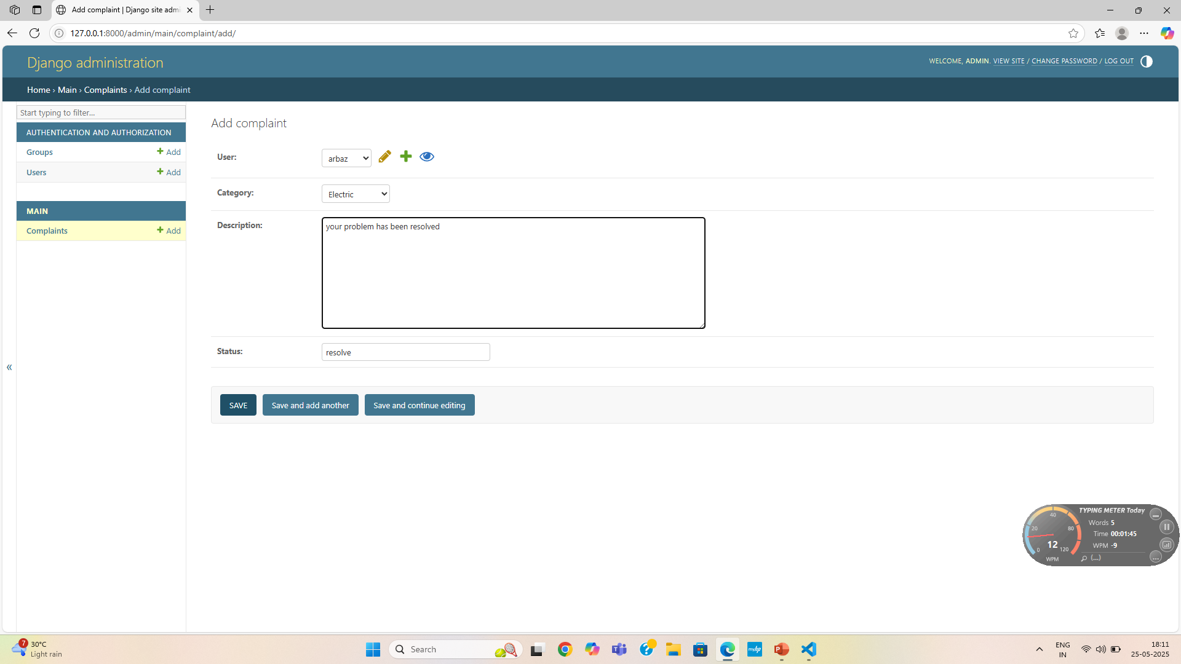
Admin Panel

Slide 11
Benefits
Quick and easy complaint registration
Easy to view your complaint history
Organized complaint management

Slide 12
Challenges
Connecting Django with MySQL
Managing user sessions securely
Designing a responsive UI

Slide 13
Conclusion
Fully functional web application
Solves a real-world problem
Can be expanded with notifications or mobile support

Slide 14
Thank You
Thank you for your time and attention.

